Slide 1
Pathway analysis
Biostat & Bioinfo short course series
Jianying Li

Slide 2
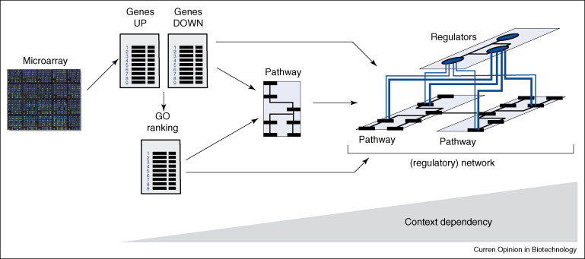
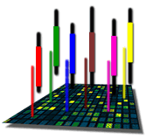
The Road to Pathway Analysis
Next Gen RNA-Seq
Adapted from Werner (2008), Current Opinion in Biotech., 19:50-64
Notes:
2

Slide 3


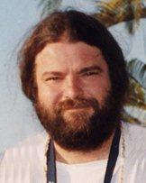

Acknowledgment
QB for kindly organization
Dr. Pierre Bushel, kindly providing slides, advice/guide, and proof-read
Dr. David Fargo for advice and guide
Support from the team
All attendees and your attention!

Slide 4
Objectives
Knowledge based pathway analysis
Two major statistical approaches
Parametric: Hypergeometric/Fisher Exact Test (FET)
Non-parametric: Kolmogorov-Smirnov/ranking statistics
Commonly-used applications, pros and cons
The proceedings in pathway analysis research

Slide 5
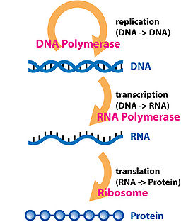
What do we mean by pathway?
Central Dogma
Involvement of Gene Products
Biological process or molecular function
Metabolic processes
Signaling cascades
Genes are categorized based on some criteria

Slide 6
Gene sets (biological categories)
Genes (sets) have something in common
On the same cytogenetic band
Coding for proteins that are part of the same cellular component
Can be part of the same biochemical pathway
Co-expressed under certain conditions
Putative targets of same regulatory factor
….

Slide 7
Gene Ontology
Gene Ontology (GO) Consortium was established in 1998 to developed shared, structured vocabulary (an ontology) for the annotation of molecular characteristics across different organisms.
a collaborative effort to address the need for consistent descriptions of gene and gene products in different databases
Original members of the consortium: SGD, FlyBase and MGD
Two primary purposes for an ontology:
to facilitate communication between people and organizations
to improve upon the interoperability between systems

Slide 8
GO structure
The ontologies are structured vocabularies in the form of directed acyclic graphs (DAGs)
The DAG represents a network (not a tree) in which each term may be a child of one or more than one parent
The relationships of child to parent can be of the “is a” type or the “part of” type

Slide 9
Ontologies within GO
molecular function describing activities, such as catalytic or binding activities, at the molecular level
biological process referring to a biological objective to which the gene product contributes
cellular component referring to the place in the cell (i.e. the location) where a gene product is found

Slide 10
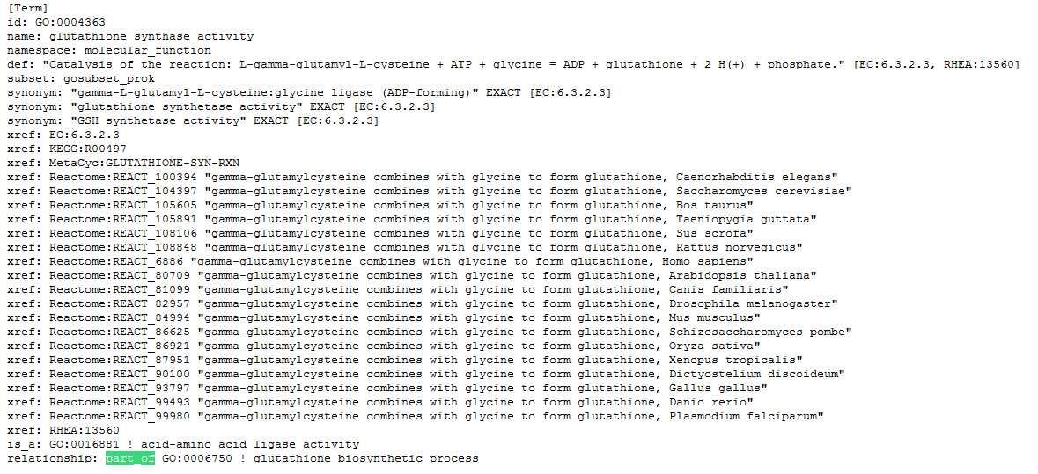

Slide 11
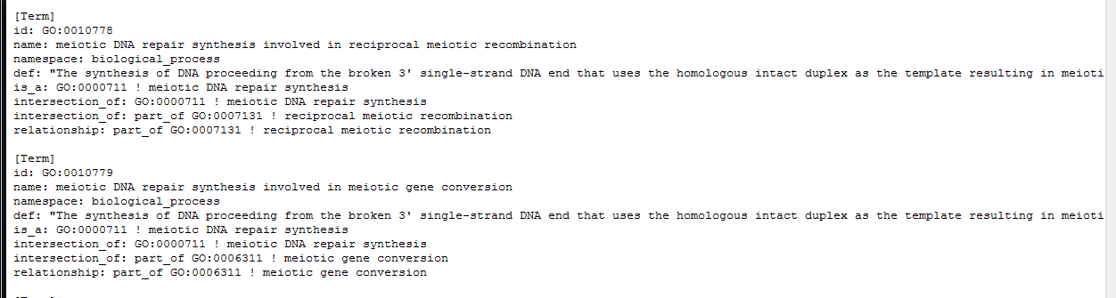

Slide 12
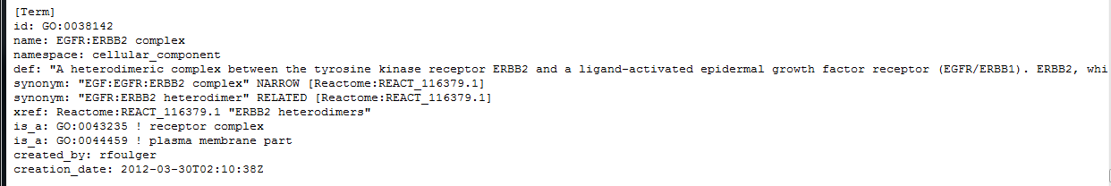

Slide 13
KEGG: Kyoto Encyclopedia of Genes and Genomes
About KEGG
Category in KEGG
Kyoto Encyclopedia of Genes and Genomes (KEGG) knowledgebase was developed in 1996 consisting of genetic building blocks of genes and proteins.
A collection of manually drawn pathway maps representing current knowledge on the molecular interaction and reaction networks
Manually curated based on published literature
Constructed as wiring diagrams with enzymes and proteins, processes and reactions and substrates, co-factors, intermediates, metabolites and end products
Metabolism: carbohydrates, energy, lipid, nucleotides, amino acid, xenobiotics
Genetic information processing
Environmental information processing
Cellular processes
Human diseases
Drug development: the structure relationships

Slide 14
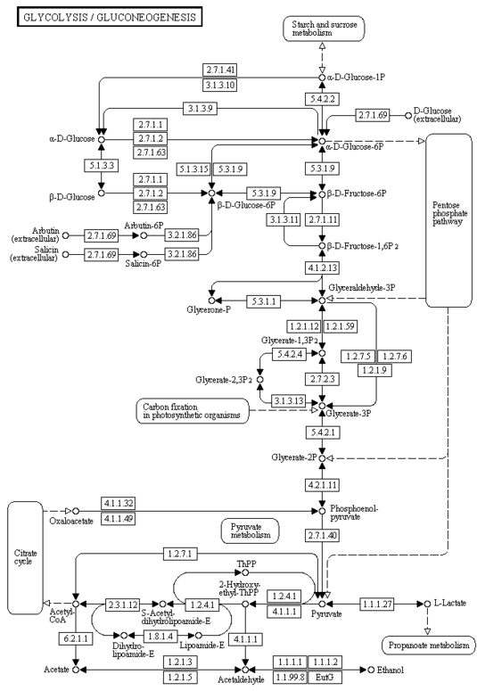

Slide 15
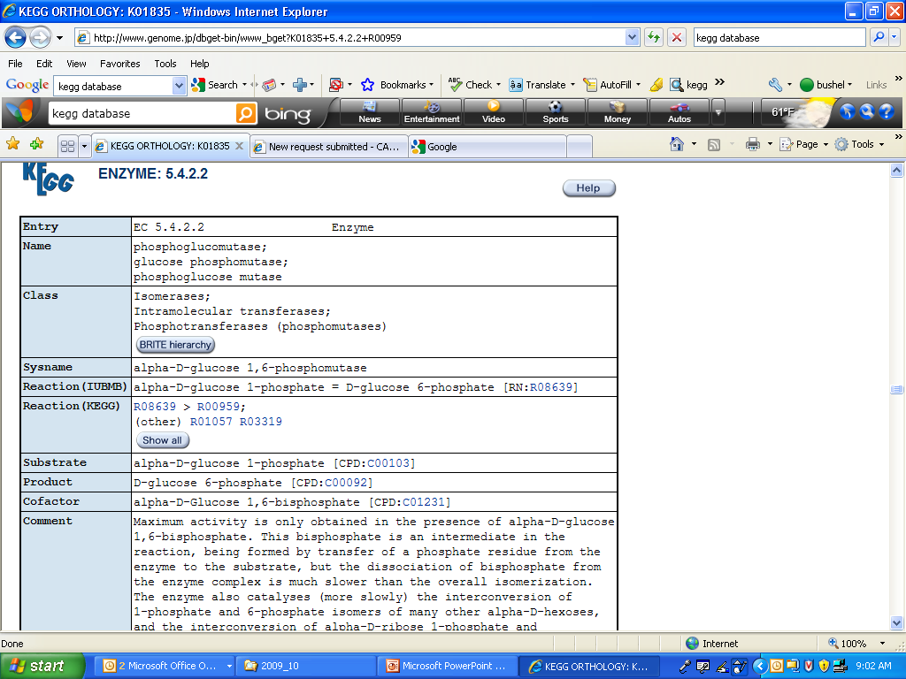

Slide 16
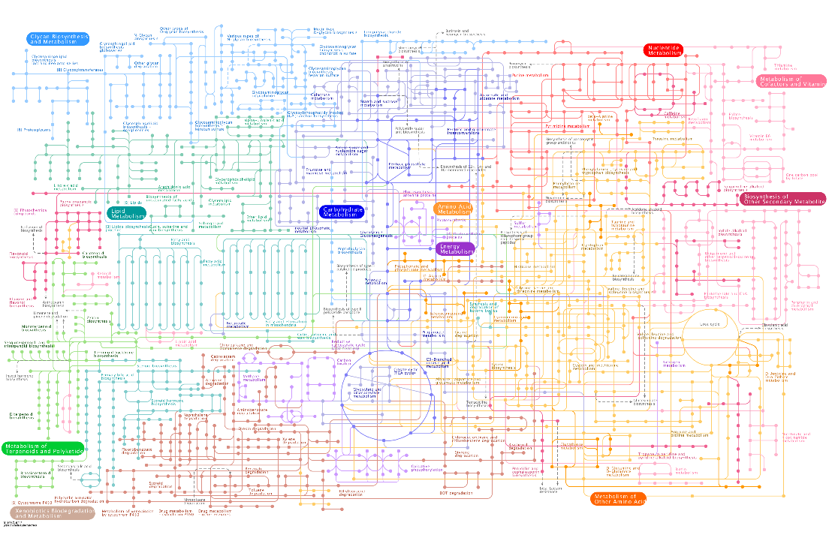

Slide 17
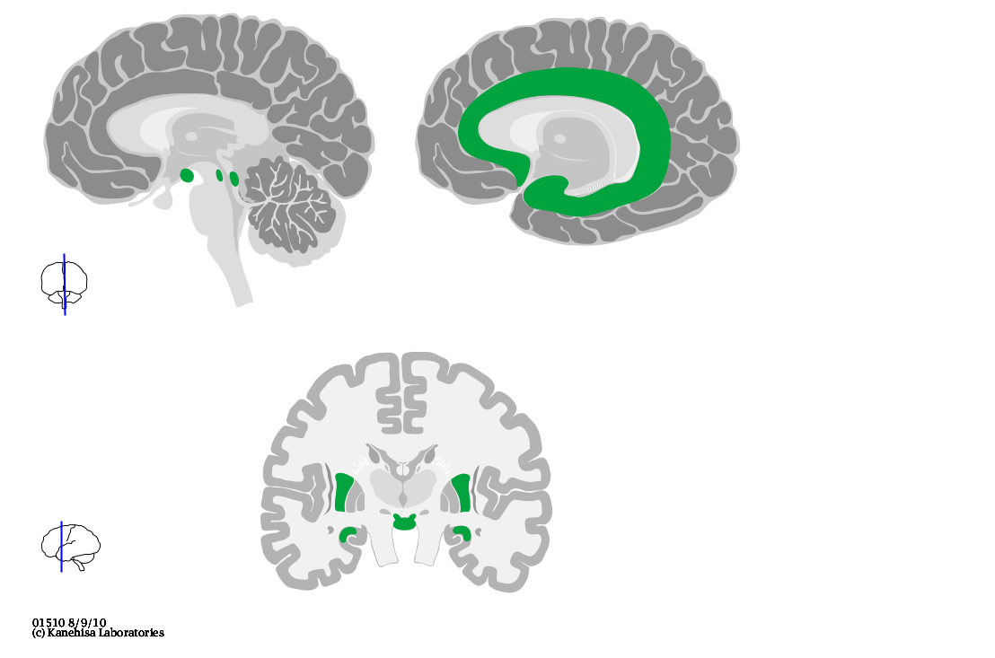

Slide 18
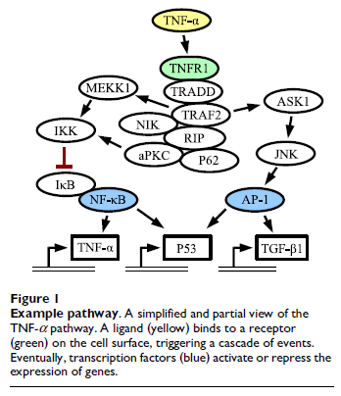
Signaling Pathways
Experimentally validated
Transfac - data on transcription factors, their experimentally-proven binding sites, and regulated genes.
The compilation of binding sites allows the derivation of positional weight matrices.
Transpath – data about molecules participating in signal transduction pathways and reactions for a network of signaling components.
Focuses on the signaling cascades of transcription factors that alter the expression of genes.
Breslin et al., BMC Bioinformatics, 2005, 6:163

Slide 19
Biological Resources Recap
Of the biological resources discussed, what does each contain?
Gene Ontology: _________, ________ & _________
KEGG: ______________ & ________________
Transfac\Transpath: ____________, ____________,
______________, & _______________

Slide 20
Biological Resources Recap
Of the biological resources discussed, what does each contain primarily?
Gene Ontology: Biological Process, Molecular Function & Cellular Component
KEGG: Molecular Interactions & Reaction Networks
Transfac\Transpath: TFs, Binding Sites, Regulated Genes, & Signaling Cascades_

Slide 21
More on gene set collections
Gene Ontology (GO)
Cellular components (CC)
Biological processes (BP)
Molecular functions (MF)
Well curated pathway database
KEGG pathway
Biocarta
GenMAPP
IPA pathway database
Gene set collections
MSigDB
GAzer

Slide 22
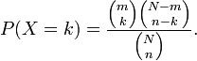
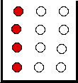
Hypergeometric Distribution
for k = 0,1,2,…,n
k<=m, n-k <=N-m
A discrete probability distribution that describes the number of successes (k) in a sequence of n draws from a finite population without replacement
An urn with two types of marbles:
N total # of marbles
Of which, m # of red marbles
Drawing a red marble is a success!
Drawing a white marble is a failure!
n is the # of marbles randomly drawn
k is the # of successes (red marbles) in the sample
Hypergeometric distribution gives the probability
P(k=2, n, m, N) = 0.339
Cumulative dist.:
P(k<=2) = 0.933

Slide 23
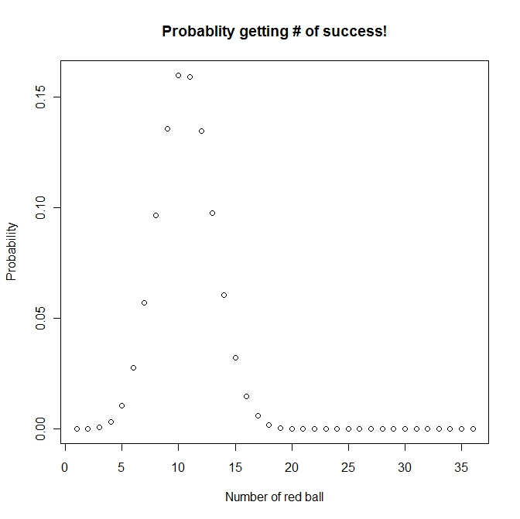
Hypergeometric distribution
Number of red ball: 50
Number of white ball: 120
Number of ball drawn (without replacement): 36
Possible number of success ??
(0,1, 2, ….36),
Probability to get 20 red balls is: 0.0001494571
http://www.aiaccess.net/English/Glossaries/GlosMod/e_gm_hypergeometric.htm

Slide 24
Rationale (an analogy)
A study with gene expression microarray, now RNAseq (total # of genes -- N)
Experiment samples from two or more conditions (control vs. treated, wild type vs knock out, etc.)
Several biological replicates at each condition
Differentially Expressed Genes (DEGs) obtained from statistical models (total # of genes drawn -- n)
Of which, k genes belong to a pathway
There are totally m genes (out of N) belong to this pathway
Is this pathway (the biological process) significantly enriched? (Perturbed? Turned on? Involved?)

Slide 25
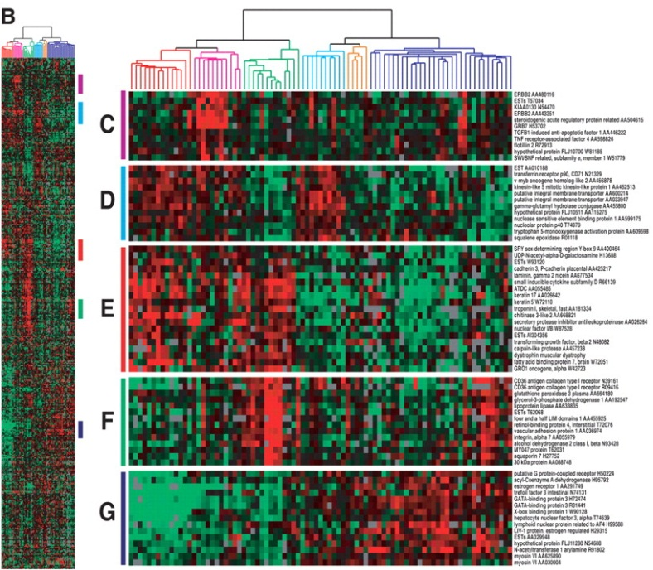
Hypergeometric Distribution/Test in the context of gene expression
Models the probability the of observing k genes from a cluster of n genes by chance in a pathway or biological process category containing m genes from a total genome (or array) size of N genes.
The p-value indicates the probability that the biological process
category (particular pathway) is enriched by this microarray
experiment by chance. The smaller the p-val, the higher the significance

Slide 26
Pathway analysis
Gene expression analysis results
Total number of gene on a chip: 520
Of which 20 genes are in a GO
Total number of DEG: 40
Of which 5 genes are in GO
Do you think it is significant? In other words “is this GO category enriched by/significant this microarray experiment”?
The answer is simple, which is to perform a hypergeometric test: phyper(4, 20, 500, 40, lower.tail=FALSE) = 0.01371
Sometime people report: phyper(5, 20, 500, 40, lower.tail=FALSE) = 0.002459

Slide 27
Fisher’s Exact Test (FET) --right-tailed test
Contingency table
DEG Not DEGs totals
In a GO category x m-x m
Not in GO category k-x n-k+x n
totals k m+n -k m + n (genes on array)
So, now you are probably given something like the following:
x <- 5 #num_of_DEG in GO
m <- 20 #num_of_gene on chip in GO
n <- 500 #num_of_gene on chip NOT in GO
k <- 40 #num_of_DEG
Comparing hypergeometric test vs. FET, watch out!!
phyper((x-1), m, n, k, lower.tail=FALSE)
(fisher.test(matrix(c(x,(k-x), (m-x), (n-k+x)),2,2), alternative='greater'))$p.value

Slide 28
Statistical Inference Recap
According to the hypergeometric distribution for determining significance of an enriched pathway, what does each term account for?
N: ___________________
n: ___________________
m: ___________________
k:____________________

Slide 29
Statistical Inference Recap
According to the hypergeometric distribution for determining significance of an enriched pathway in a cluster, what does each term account for?
N: genome (or array) size
n: cluster size
m: # of genes with the annotation of the pathway
k: # of genes in the cluster with the annotation of the pathway

Slide 30
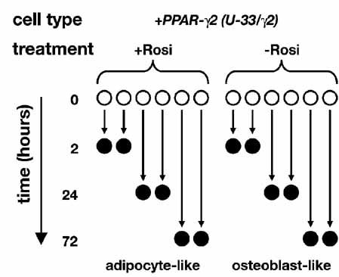
Study Design for Sample Data
Peroxisome proliferator-activated
receptor gamma
Rosiglitazone
Mouse marrow mesenchymal stem cell (MSC)
Stably transfected with PPAR-γ2
Affymetrix Mouse 430vs2
Data RMA normalized
ANOVA model
Shockley et al.,
J. Cell. Biochem, 2009, 1
06:232-246
3730 DE probe sets (q-value < 0.01)
[1634 up-regulated, 2096 down-regulated]

Slide 31

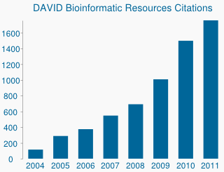
Available database in DAVID
Functional categories
Ontologies
KEGG pathway
Protein domains
Protein interactions
Disease
Tissue specific expression
…etc.

Slide 32
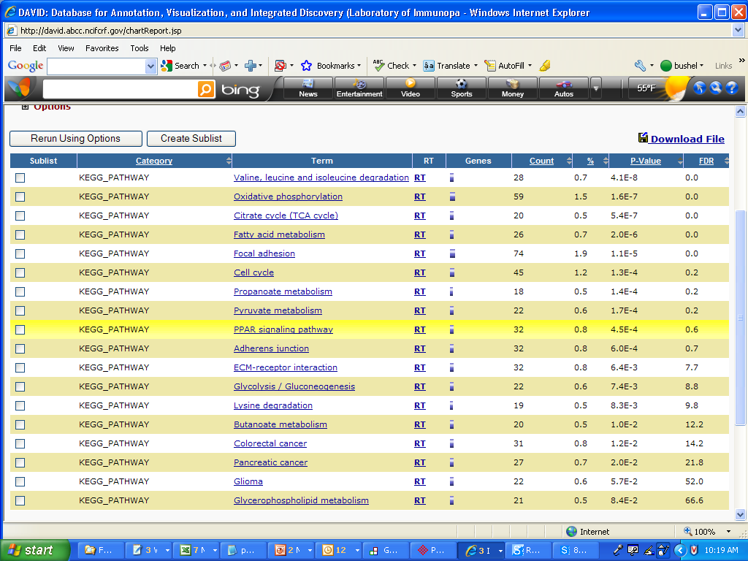
Pathways Over-represented
NIAID’s DAVID Database
Database for Annotation, Visualization and Integrated Discovery
http://david.abcc.ncifcrf.gov/

Slide 33
Ingenuity Pathway Analysis (IPA) --Knowledgebase
Desk top Java application utilizing a remote server for data, analysis and file management
IPA Ontology: Curation of the scientific literature and content extraction of the IPA repository of molecular interactions, regulatory events, biological processes, gene-to-phenotype associations, and chemical knowledge

Slide 34
IPA Enrichment Analysis
Uses the Fisher’s exact test to determine the significance of a functional group or pathway
# molecules in a list that are associated with a function/pathway (k)
total # of molecules that are associated with a function/pathway (m)
# of molecules in all possible functions/pathways (N)
# of molecules in a list (n)

Slide 35
IPA Canonical Pathway Over-representation
Canonical pathway: Highly curated metabolic and cell signaling pathways from KEGG, scientific literature
Ratio = # of genes in a pathway that meet cutoff criteria / total # of genes in the pathway

Slide 36
Parametric approach summary
Statistics tests are solid (hyper geometric/FET)
But, watch out for hypothesis formulation
And, there are a few violations (will be addressed shortly)
Knowledgebase used matters!!

Slide 37
A non-parametric approach
Based on Kolmogorov-Smirnov (K-S) test
Compare a sample empirical distribution function to the reference distribution
Or, compare two sample empirical distribution functions
The test is performed in relevant to different null hypothesis setting

Slide 38
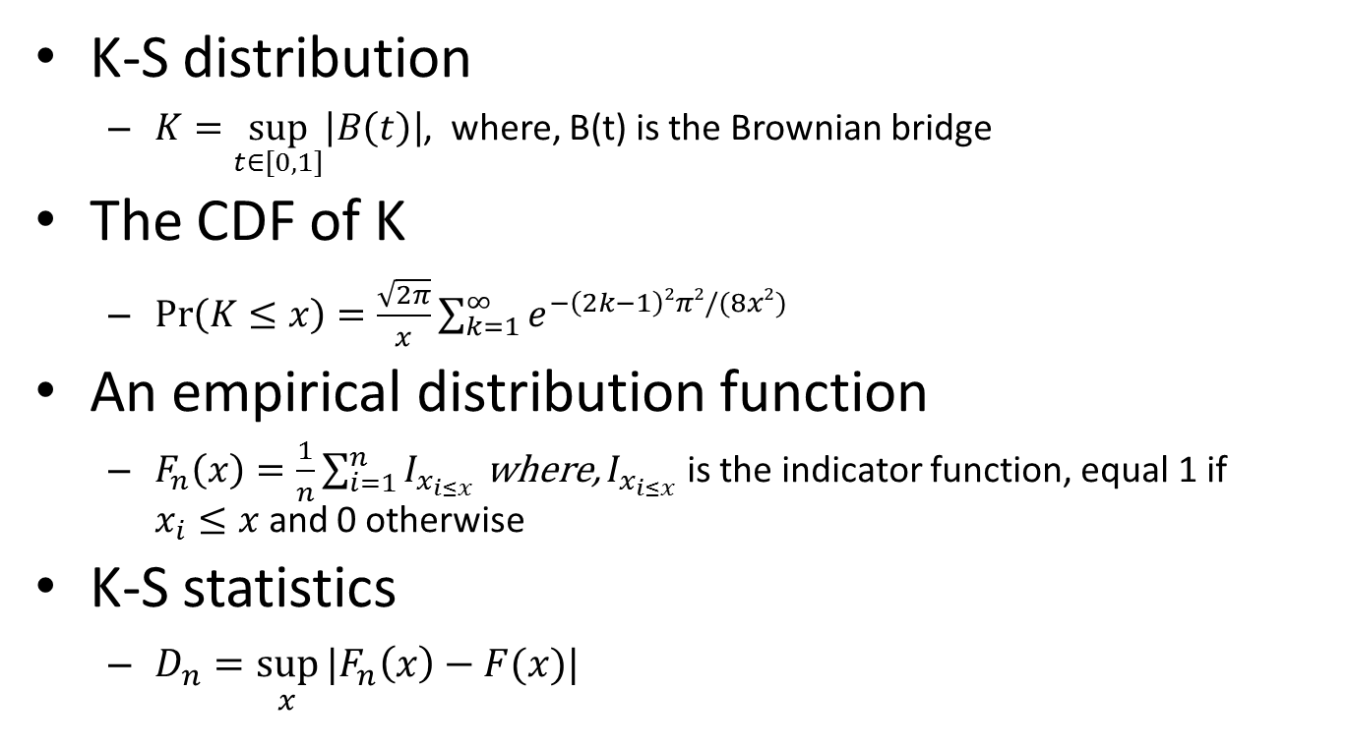
Kolmogorov-Smirnov (K-S) test
K-S distribution
$K=\sup_{t∈[0,1]}\left|B\left(t\right)\right|$, where, B(t) is the Brownian bridge
The CDF of K
$\operatorname{Pr}\left(K≤x\right)=\frac{\sqrt{2π}}{x}\sum_{k=1}^{∞}{e^{−\left(2k−1\right)2π2/(8x2)}}$
An empirical distribution function
$F_{n}\left(x\right)=\frac{1}{n}\sum_{i=1}^{n}{I_{x_{i≤x}}}$ where, $I_{x_{i≤x}}$ is the indicator function, equal 1 if $x_{i}≤x$ and 0 otherwise
K-S statistics
$D_{n}=\sup_{x}{|F_{n}\left(x\right)−F(x)|}$

Slide 39
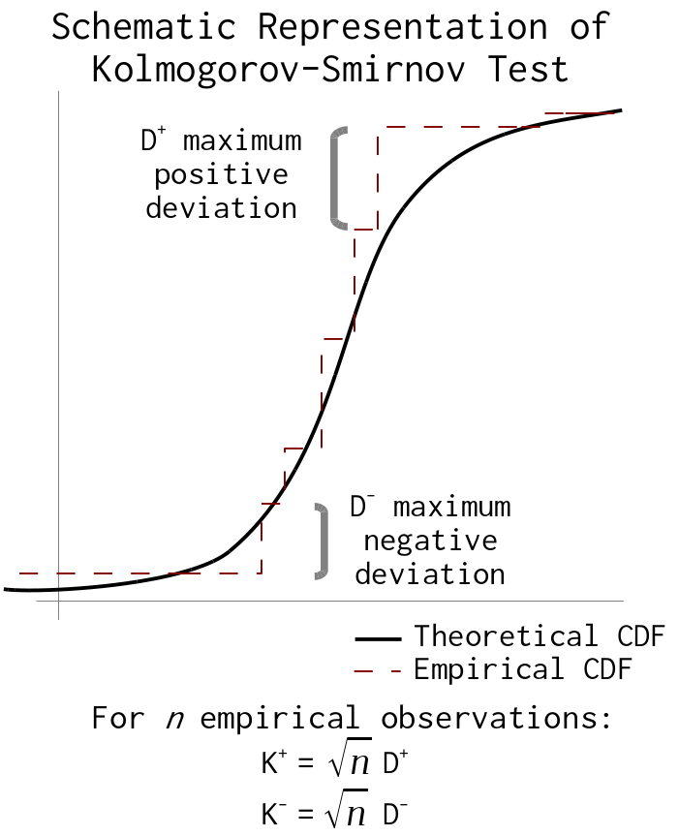

Slide 40
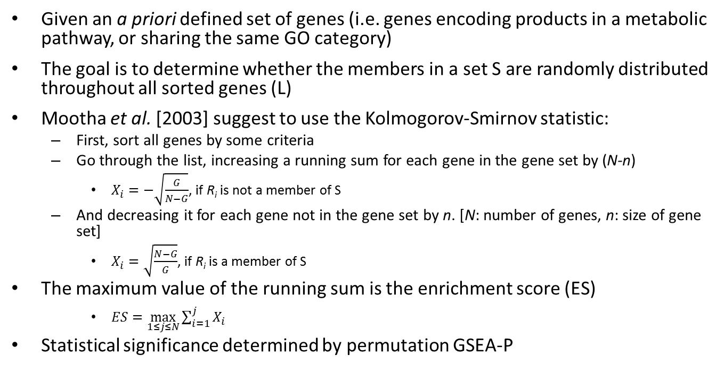
Gene set enrichment analysis (GSEA)
Given an a priori defined set of genes (i.e. genes encoding products in a metabolic pathway, or sharing the same GO category)
The goal is to determine whether the members in a set S are randomly distributed throughout all sorted genes (L)
Mootha et al. [2003] suggest to use the Kolmogorov-Smirnov statistic:
First, sort all genes by some criteria
Go through the list, increasing a running sum for each gene in the gene set by (N-n)
$X_{i}=−\sqrt{\frac{G}{N−G}}$, if R_{i} is not a member of S
And decreasing it for each gene not in the gene set by n. [N: number of genes, n: size of gene set]
$X_{i}=\sqrt{\frac{N−G}{G}}$, if R_{i} is a member of S
The maximum value of the running sum is the enrichment score (ES)
$ES=\max_{1≤j≤N}{\sum_{i=1}^{j}{X_{i}}}$
Statistical significance determined by permutation GSEA-P

Slide 41
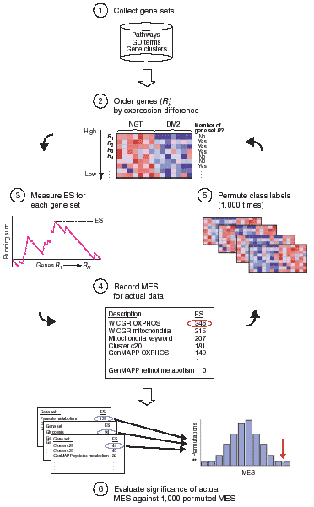
Mootha et al., Nature Genetics, 2003, 34(3):267-273

Slide 42
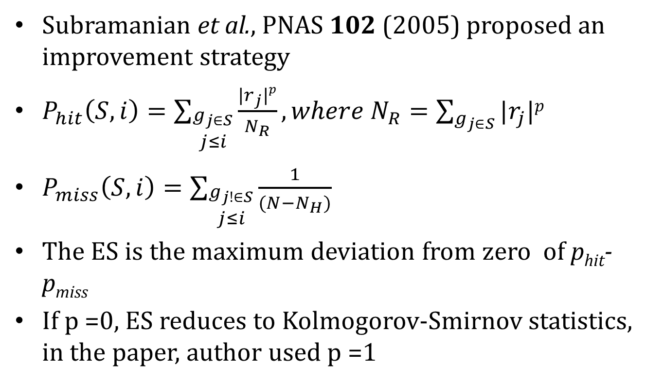
Improved KS statistics tests
Subramanian et al., PNAS 102 (2005) proposed an improvement strategy
$P_{hit}\left(S,i\right)=\sum_{\begin{aligned}g_{j∈S} \\ j≤i\end{aligned}}{\frac{|r_{j}|p}{N_{R}}},where N_{R}=\sum_{g_{j∈S}}{|r_{j}|p}$
$P_{miss}\left(S,i\right)=\sum_{\begin{aligned}g_{j!∈S} \\ j≤i\end{aligned}}{\frac{1}{(N−N_{H})}}$
The ES is the maximum deviation from zero of p_{hit}-p_{miss}
If p =0, ES reduces to Kolmogorov-Smirnov statistics, in the paper, author used p =1

Slide 43
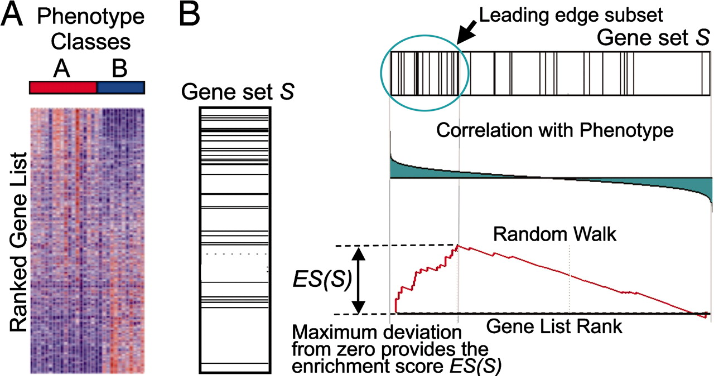
A GSEA overview illustrating the method.
Subramanian A et al. PNAS 2005;102:15545-15550
©2005 by National Academy of Sciences
Notes:
A GSEA overview illustrating the method. (A) An expression data set sorted by correlation with phenotype, the corresponding heat map, and the “gene tags,” i.e., location of genes from a set S within the sorted list. (B) Plot of the running sum for S in the data set, including the location of the maximum enrichment score (ES) and the leading-edge subset.

Slide 44
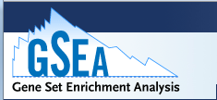
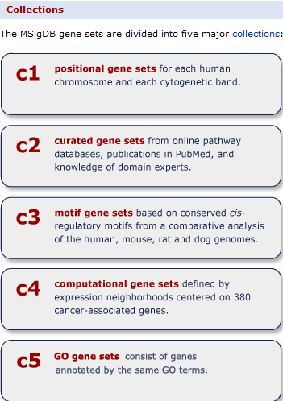
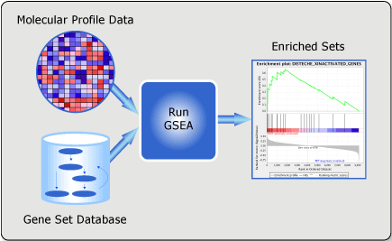
GSEA web-portal
http://www.broadinstitute.org/gsea/msigdb/index.jsp

Slide 45
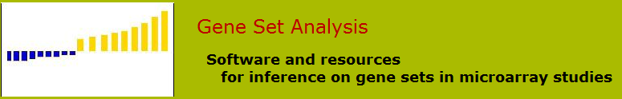
Bradley Efron and Rob Tibshirani. Tech report. August 2006
Main reference: Subramanian, A, et al. 2005 PNAS 102 15545-15550
Major improvement
Maxmean statistics for initial gene ranking
Restandardization (a combination of randomization and permutation)

Slide 46
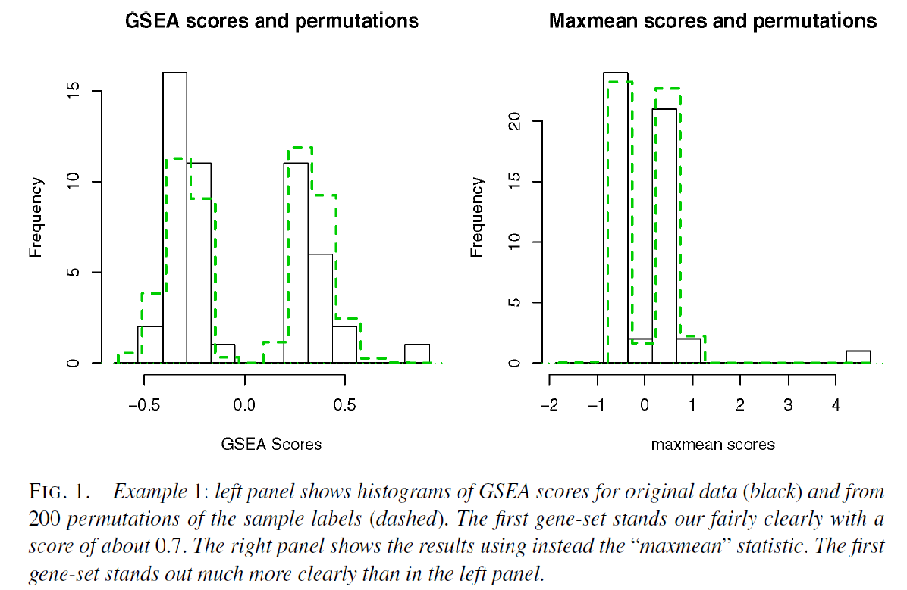
Maxmean statistics

Slide 47
Randomization vs. permutation

Slide 48
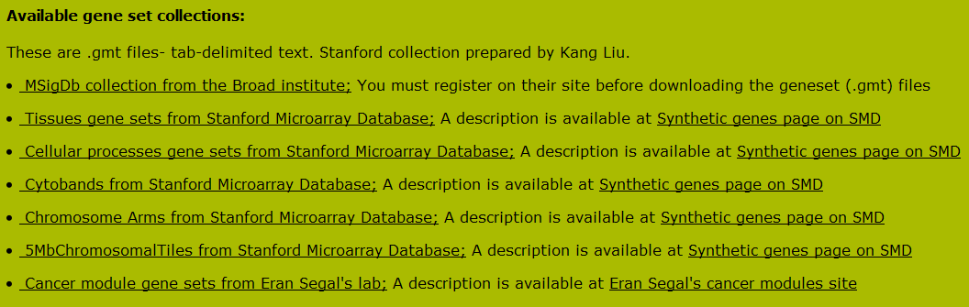
GSA – available gene set collection
GSA R package is available: http://cran.r-project.org/web/packages/GSA/index.html
Gene set collection can be downloaded from Broad or Stanford

Slide 49
Non-parametric approach
Relax on “strong assumption”
Customized gene set is allowed
Some concerns on the statistical power
Computationally intensive

Slide 50
Major concerns with GO related pathway analysis
Ignore GO hierarchy – treat each term independently
Ignore gene (expression) level/rank
Ignore correlation – assuming genes (in a category) are uncorrelated
Sampling over genes (observation)
All these make p values quite unclear

Slide 51
The universe matters
It is important to choose the universe correctly
Case 1: universe is all genes in the genome
 | DEGs | Non-DEGs | Total
In GO | 10 | 30 | 40
Not in GO | 390 | 3570 | 3960
Total | 400 | 3600 | 4000
p=0.049
Case 2: universe is only expressed genes
 | DEGs | Non-DEGs | Total
In GO | 10 | 30 | 40
Not in GO | 390 | 570 | 960
Total | 400 | 600 | 1000
p=0.0048

Slide 52
Sets are overlapped
A
B
Set B is enriched only because of it overlap with set A

Slide 53
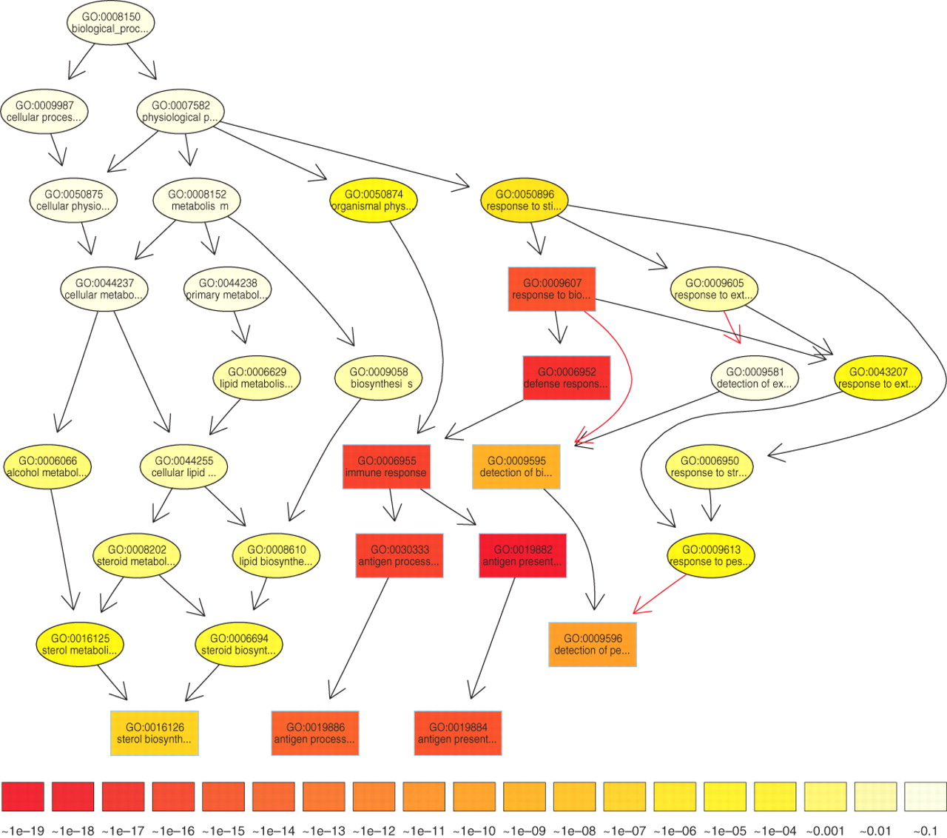

The subgraph induced by the 10 most significant GO terms identified by a current state-of-the-art method for scoring GO terms for enrichment.
TopGO’s elimination algorithm
Test the leaf sets first. If significant,
remove its “genes” before testing its
ancestor sets
TopGO’s weight algorithm
The genes are weighted by their relevance
in the significant nodes.
The enrichment score of a parent (gene
node u) is compared with the scores of
its children.
Children with a better score than u
represent the interesting genes better.
Therefore, their significance is increased
Children with a lower score than u have
their significance reduced.
Alexa A et al. Bioinformatics 2006;22:1600-1607
© The Author 2006. Published by Oxford University Press. All rights reserved. For Permissions, please email: journals.permissions@oxfordjournals.org
Notes:
The subgraph induced by the 10 most significant GO terms identified by a current state-of-the-art method for scoring GO terms for enrichment. Boxes indicate the 10 most significant terms. Box color represents significance, ranging from dark red (most significant) to light yellow (least significant). The numbers in the legend represent the magnitude of the raw p-values associated with the respective color. Black arrows indicate is–a relationships and red arrows part–of relationships.

Slide 54
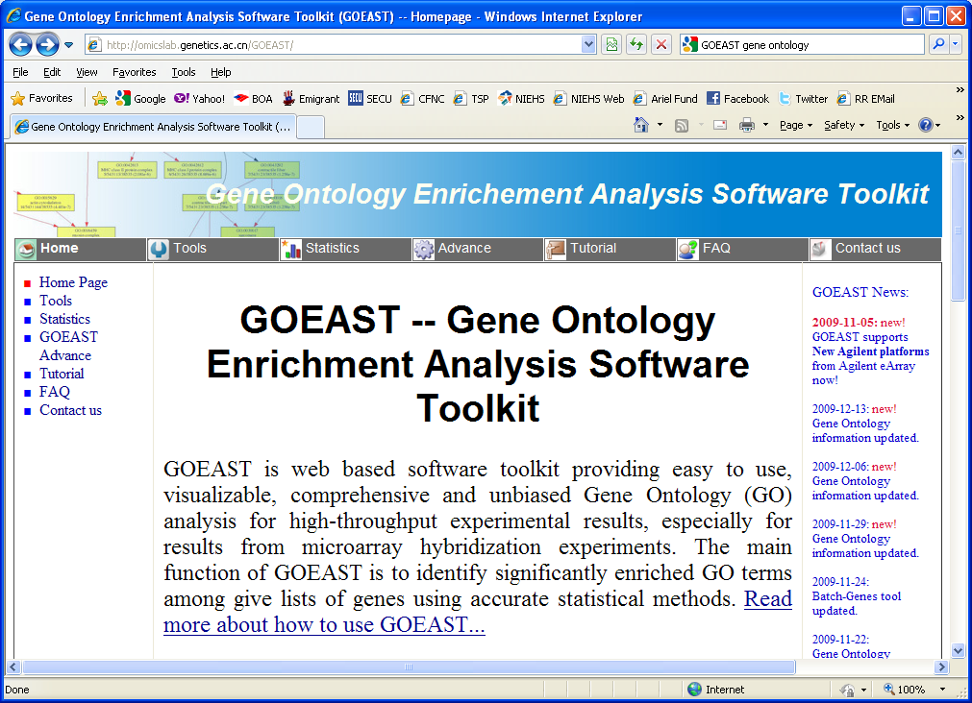
Open web browser and navigate to :
http://omicslab.genetics.ac.cn/GOEAST/
At the header tool bar, click on Tutorial
Notes:
54

Slide 55
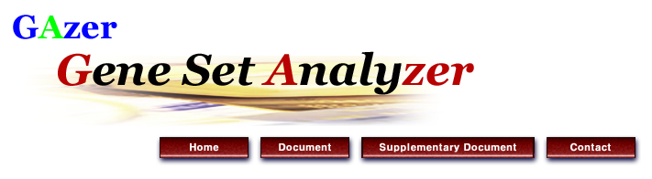


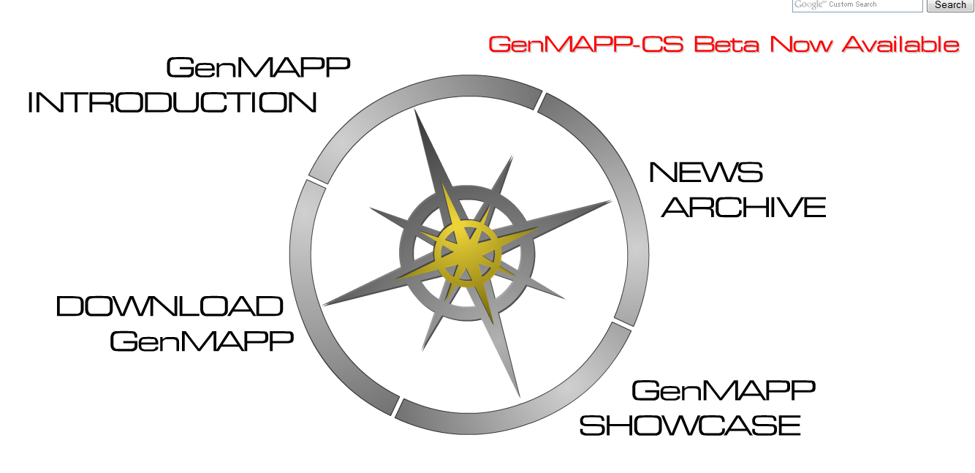

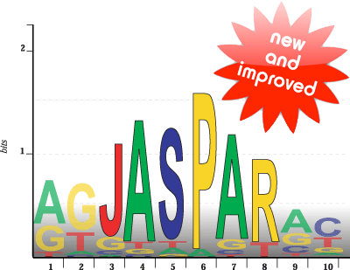





Slide 56
http://www-stat.stanford.edu/~tibs/GSA/
http://www.netsci.org/Resources/Software/Bioinform/pathwayanalysis.html
http://www.broadinstitute.org/gsea/index.jsp
http://david.abcc.ncifcrf.gov/
http://www.biocarta.com/
http://web.expasy.org/pathways/
http://www.genmapp.org/
http://www.genome.jp/kegg/
http://www.ingenuity.com/
http://www.genego.com/metacore.php
http://www.geneontology.org/
http://omicslab.genetics.ac.cn/GOEAST/tutorial.php
http://expressome.kobic.re.kr/GAzer/document.jsp
http://www.biobase-international.com/products
http://jaspar.genereg.net/

Slide 57
Pathway analysis Recap
Two major statistics approaches:
_________ with tests are ________ & _________
__________ with two major implementations ___________
& _____________
Same number of DEGs and those in a category, what could possibly be matter whether to get a significant p-value _________
What are a few known concerns with conventional GO based pathway analysis: ____________, ____________,
______________, & _______________

Slide 58
Pathway analysis Recap
Two major statistics approaches:
Parametrics with tests are hypergeometric test & Fisher exact test
Non-parametrics with two major implementations GSEA &
GSA
Same number of DEGs and those in a category, what could possibly be matter whether to get a significant p-value the universe matters
What are a few known concerns with conventional GO based pathway analysis: Ignore GO hierarchy , Ignore gene (expression) level/rank, assuming genes are uncorrelated & sampling over genes

Slide 59
Pathway analysis summary
Two major statistics approaches
Parametric vs. non-parametrics
Many available databases
Gene Ontology
KEGG
Transfac & transpath
A few popular applications
DAVID (free online)
GSEA (online and desktop java application)
GSA (R –package)
Ingenuity Pathway Analysis (licensed based)
Biobase/JASPER (license based)
GeneGO (license based)

Slide 60
Question??

Slide 61
Click on tools on the side menu bar to display platforms
Notes:
61

Slide 62
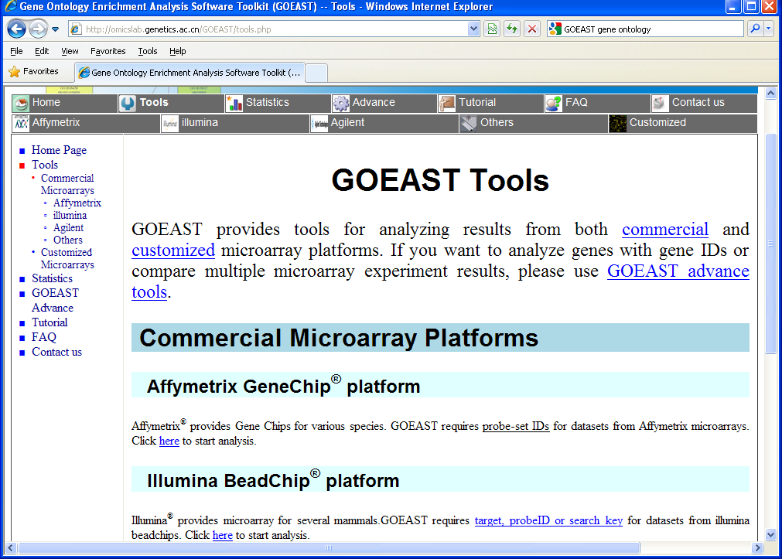
Click here to start an Affymetrix gene expression based analysis
Notes:
62

Slide 63
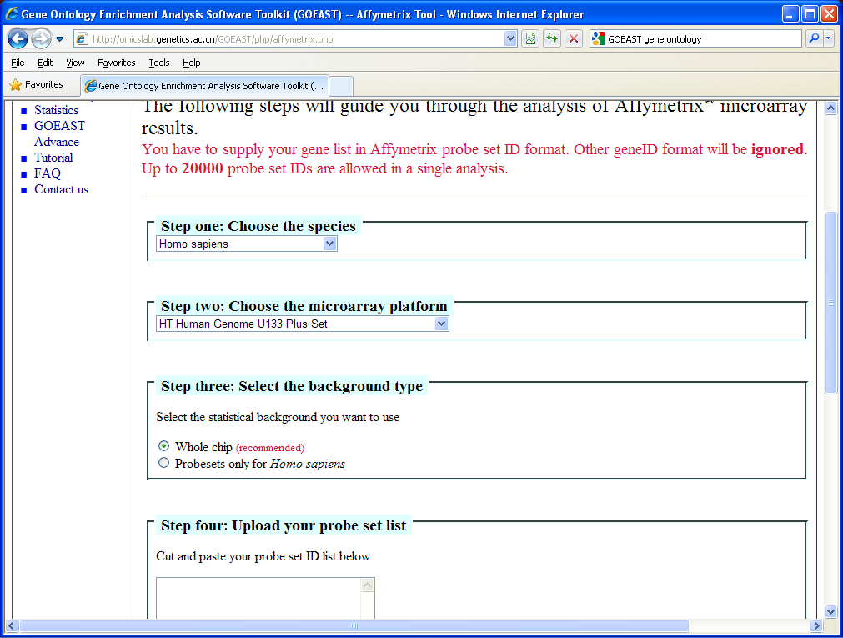
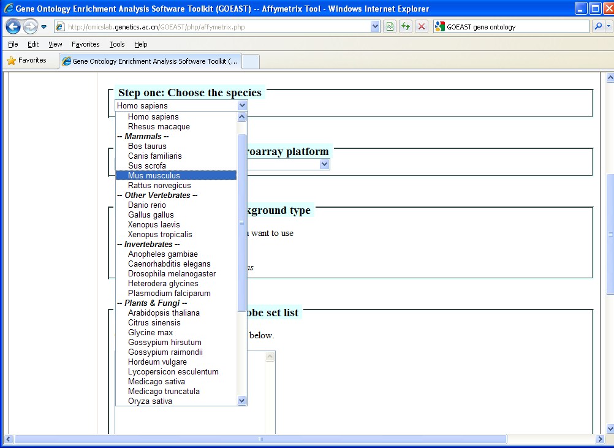
Step 1) Choose the species.
Select Mus musculus as the species.
The web page will dynamically populate the platforms available for this species
Notes:
63

Slide 64
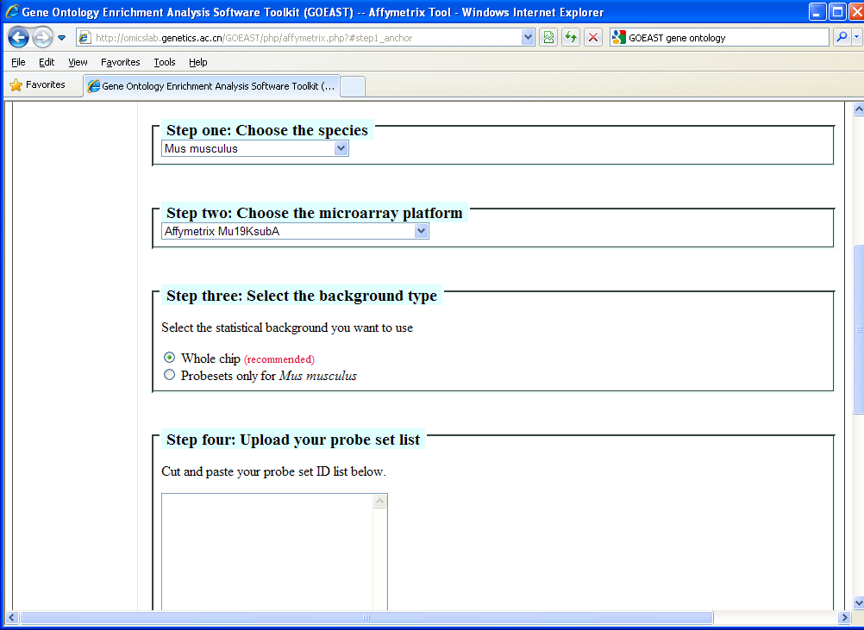
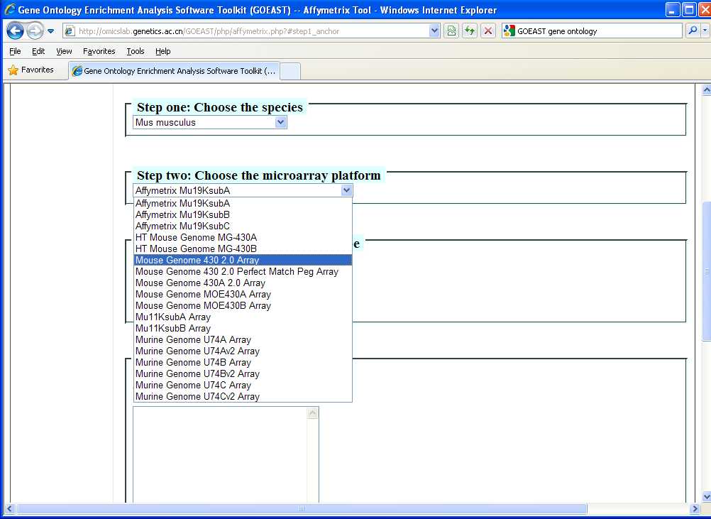
Step 2) Choose the microarray platform
Select mouse genome 430 2.0 Array as the microarray platform.
Notes:
64

Slide 65
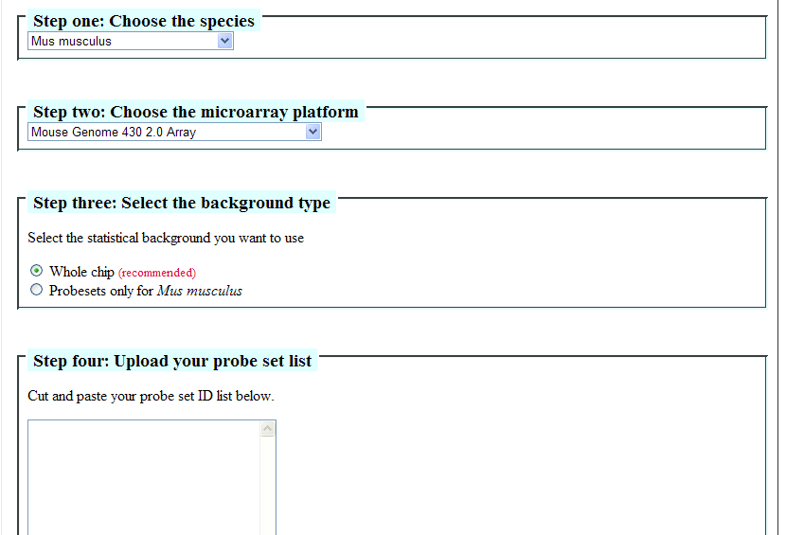
Step 3) Select the background (population) type. Leave whole chip selected
Notes:
65

Slide 66
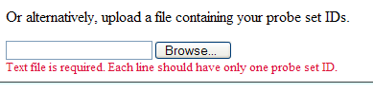
Step 4) Upload probe set.
Cut and paste list of Affymetrix probe set IDs from the differentially expressed genes to the entry box . Use probe set IDs in 72_hr_DEGs_Q_top_500.txt
Notes:
66

Slide 67
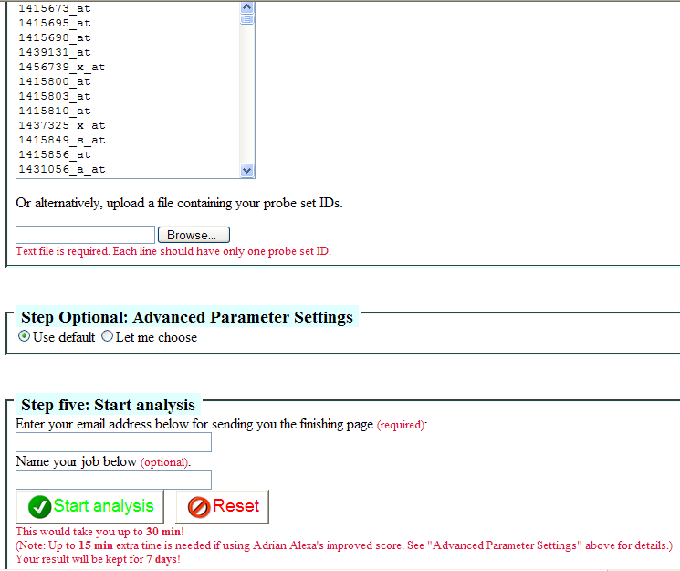
Use the default option for parameter settings.
Step 5) Enter a valid email address that you have access to.
Give the analysis a distinct name to identify it from the results that will be emailed to you.
Click Start analysis
Notes:
67

Slide 68
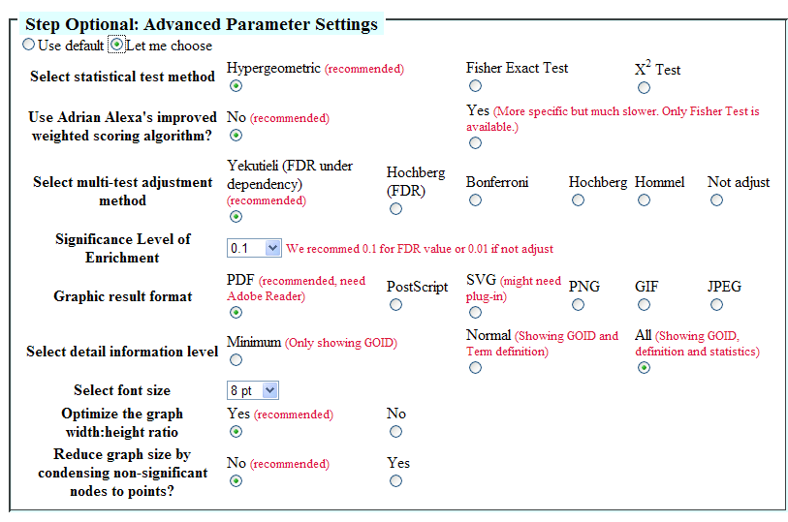
Notes:
68

Slide 69
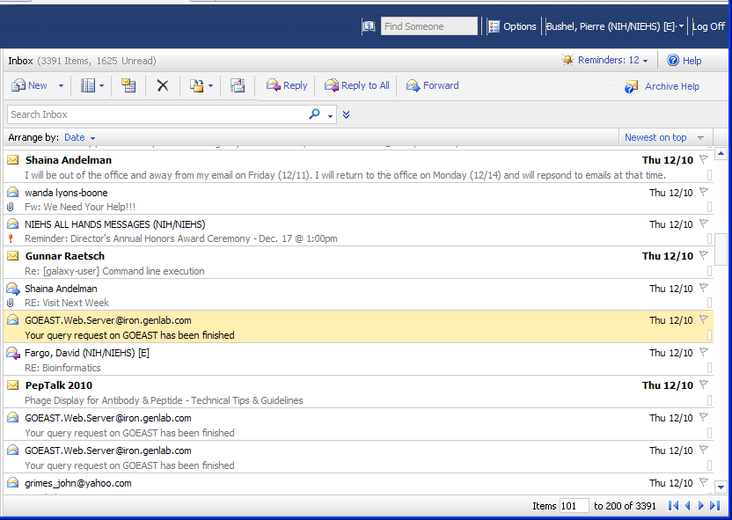
Email notification when analysis is complete
Notes:
69

Slide 70
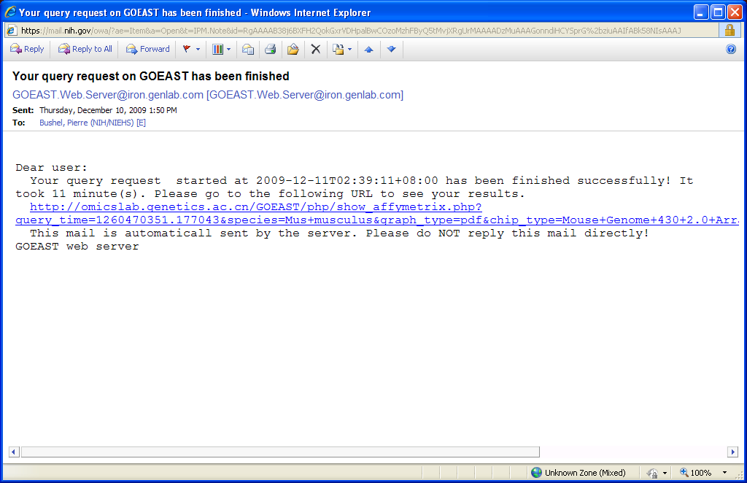
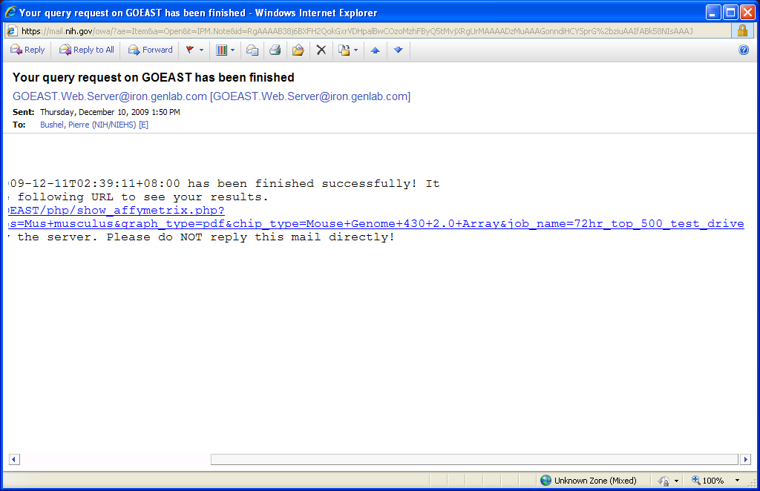
Click on hyperlink to display results in your web browser
Notes:
70

Slide 71
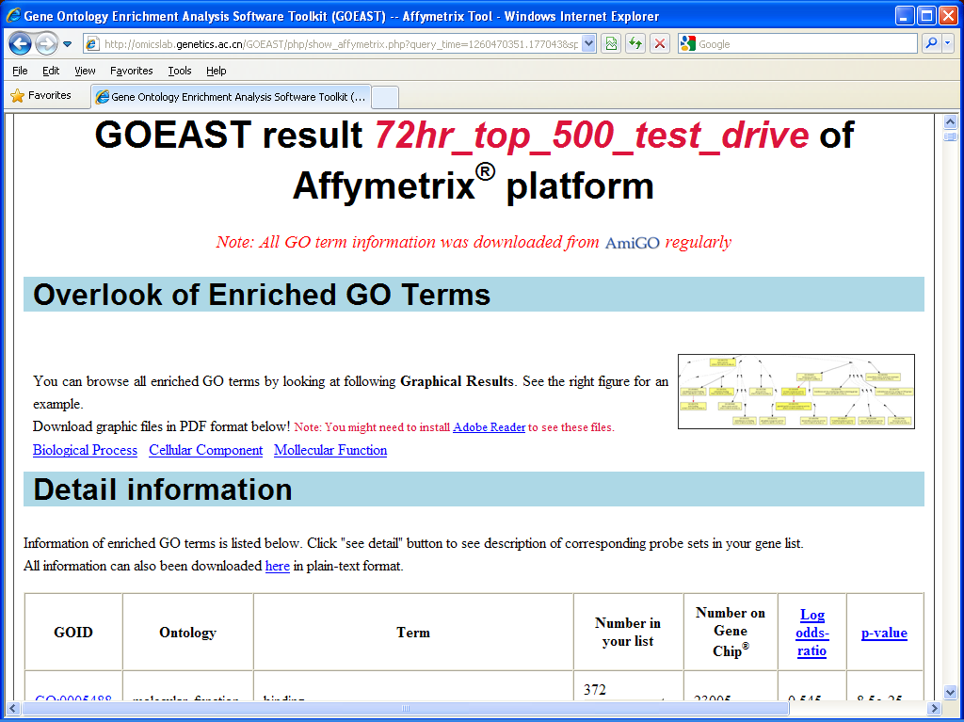
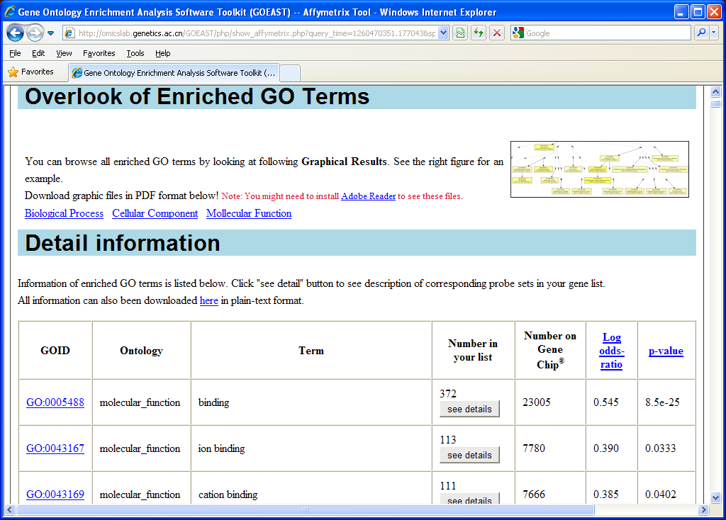
Notes:
71

Slide 72

Use Advanced settings to run GO enrichment using Adrian Alexa’s weighting approach.
3730 classic →18 minutes
Top 500 classic →11 minutes
Top500 WT →15mins
Notes:
72

